Slide 1
Ames Housing Complex, LOWA Analysis By Upasana Mahanta

Slide 2
INTRODUCTION
Population: 3,155,070 in 2019, in the top ten for the state of Iowa.
Density: 52.7 people per square mile.
Major employers: State/federal agencies
Ranked in the top 15 "Cities that have done the best since the recession" by Bloomberg
Ames is a moderately-sized town smack-dab in the middle of Iowa, containing Iowa State University (ISU) and nestled between the state's major east-west and north-south highways
Lowa State University is just west of the center of town; this has a big impact on adjacent and nearby properties.

Slide 3
Cleaning data
Cleaning all null values of main 23 categorical features
Get dummies for all required features

Slide 4
Data visualization

Slide 5
Data contain total 81 features and 2051 Id house 878 ID house for prediction
Sample size

Slide 6
datatypes of sale price
Count 2051.000000
Mean 181469.701609
Std 79258.659352
Min 12789.000000
25% 129825.000000
50% 162500.000000
75% 214000.000000
max 611657.000000
The average sale price of a house in our dataset is close to $180,000,
With most of the values falling within the $130,000 to $215,000 range.

Slide 7
Feature Engineering

Slide 8
distribution of features
The categorical features will be much more interesting when compared to our target feature Sale Price
Mainly Sq. ft ,Garage Year Built ,Total rooms showing positive skew ,linearly they are related with price
We find that there are quite a few features that seem to show strong correlation to Sale Price, such as Overall Qual, Total Bsmt SF, Total_ sqft., and Year Remodel/Add. This confirms our natural intuition: we would expect that high quality, big house with big lot area with overall quality to be more expensive.

Slide 9
Correlation matrix

Slide 10
box plot

Slide 11
Correlation matrix with NEIGHBORHOOD
We see four clusters of neighborhoods above.
Neighborhood 1: MeadowV : BrDale
Neighborhood 2: BrkSide : Mitchel
Neighborhood 3: SawyerW : Veenker
Neighborhood 4: Timber : NoRidge

Slide 12
Correlation matrix of price with Year sold
Ames seems to have been immune at the Recession time .
There for may be ,Given the city's being ranked by Bloomberg in the top 15 "cities that have done best since the recession".(Wikipedia shows)

Slide 13
distribution matrix of price with year built
Oldest house built in 1872. Newest house built in 2010.
Not much action in the 80s apparently. Looks like majority of houses were built in the 50s and after,
1985-2010: Extended growth leading up to the Great Recession
Year Built

Slide 14
Correlation matrix
Ground Living Area shows high big houses were made
The average house has 1,499 sq. ft of space, the median 1,444 sq. ft.
Biggest house has 5,642 sq. ft of space, the smallest 334 sq. ft

Slide 15
Model fitting and evaluation

Slide 16
X variables
Total_ Sqft.= Total Bsmt SF+Wood Deck SF+Open Porch SF+1st Floor SF+2nd Floor SF
Total SF , Lot Area ,Year Remodel/Add, Overall Qual, Basement Unfinished SF, Year Remodel/Add * Overall Qual
Year Remodel/Add * Overall Qual= Year Remodel/Add, Overall Qual
Split the data into two data sets , Training set: What we "train" a model on
Holdout set: What we use to validate our "trained" model

Slide 17
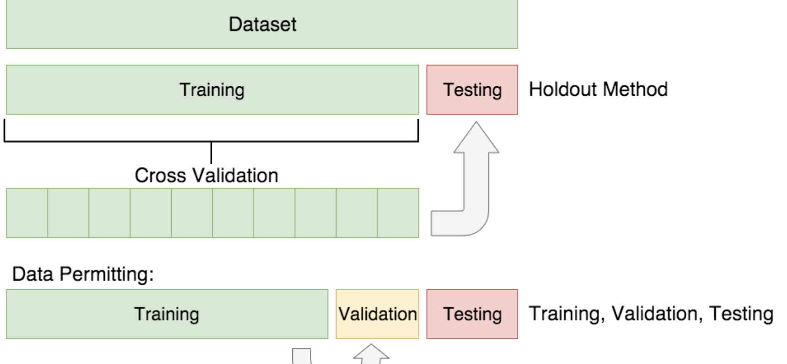

Slide 18
Evaluation of regression model
Test set score
0.8556282468368013
Training set score
0.7974330694026652
Cross value score of training set
0.7718800193095575

Slide 19
Model details
Training Scores:
R2 score: 0.7974330694026652
Training r2 score .79 This means that our features explain approximately 80% of the variance in our target variable.
Testing Scores:
R2 score: 0.8556282468368013
P-value: 0.0

Slide 20
Findings & recommendation

Slide 23
Cont….
Seasonal pattern in House hold, with peaks in June and July.
Looks like a good chunk of houses are in North Ames, Collect Creek, and Old Town, with few houses in Bluestem, Northpark Villa and Veenker.

Slide 24
Cont….
The average lot is 0.23 acres, the median 0.22 acres The biggest lot is 3.65 acres, the smallest 0.03 acres
We can see that both the square footage of a house and lot size are positively skewed,
but lot size much more so with plenty of outliers.
It will definitely impact these outlier with price

